Slide 1


Agentic Coding
Improves coding efficiency
*Part of materials adapted from missing-semester, MIT

Slide 2
Before we begin…
Agentic Coding tool are NOT meant to replace all your individual works, especially when it comes to courseworks!
You are responsible for using the tool, and checking school regulations for AI usage policy
Some courses may explicitly allow you to use such tools, while others may not!

Slide 3
How Large Language Model works
LLMs are probabilistic models for natural language
  Giving a prompt/input, the model computes a probability distribution of output words
  Then model the choose the most probable word and repeat the whole process until it produces EOS (End Of Sentence) symbol
  Output from last turn of chat is concatenated to the input of the next turn
  And they have a context window, which you can think of as its “memory capacity”

Slide 4
How Large Language Model works - continued
Each word/subword/affix produced by the LLM is called a ‘token’, and typically the companies put a limitation on the number of tokens the LLM is allowed to produce
You can think of this as a ‘LLM currency’, you pay for more tokens, and LLMs can do more things for you

Slide 5
When it comes to Agentic Coding
Agentic Coding tools are just LLM + harness
LLM itself can only produce text, and it is the harness tool that interpret the text, and do useful things
  Execute commands,
  Read images,
  etc.
When the harness finishes executing the output is then feed back to LLM, and this loop continues

Slide 6






General workflow
Repeat
User prompt
LLM interpret + generate text
LLM harness execution
Execution results
Present final artifact and summary
User verify
Result feedback to LLM, loop

Slide 7
How to use them in IDEs

Slide 8
Download Agentic Coding in IDEs
Take VS Code as an example, it supports GitHub Copilot extension
  As a student, you can use it freely by apply GitHub Education
  https://github.com/education/students
Alternatively, you can use Codex or Claude Code, but you probably need to pay for their plans to get more tokens

Slide 9
Using Agentic Coding tools in IDEs
There more than one way to use those tools in IDEs
  Autocomplete: Good for local changes pass your cursor
  In-line chat: Good for making adaptations to a selected area of code
  General chat: Capable for most cases

Slide 10
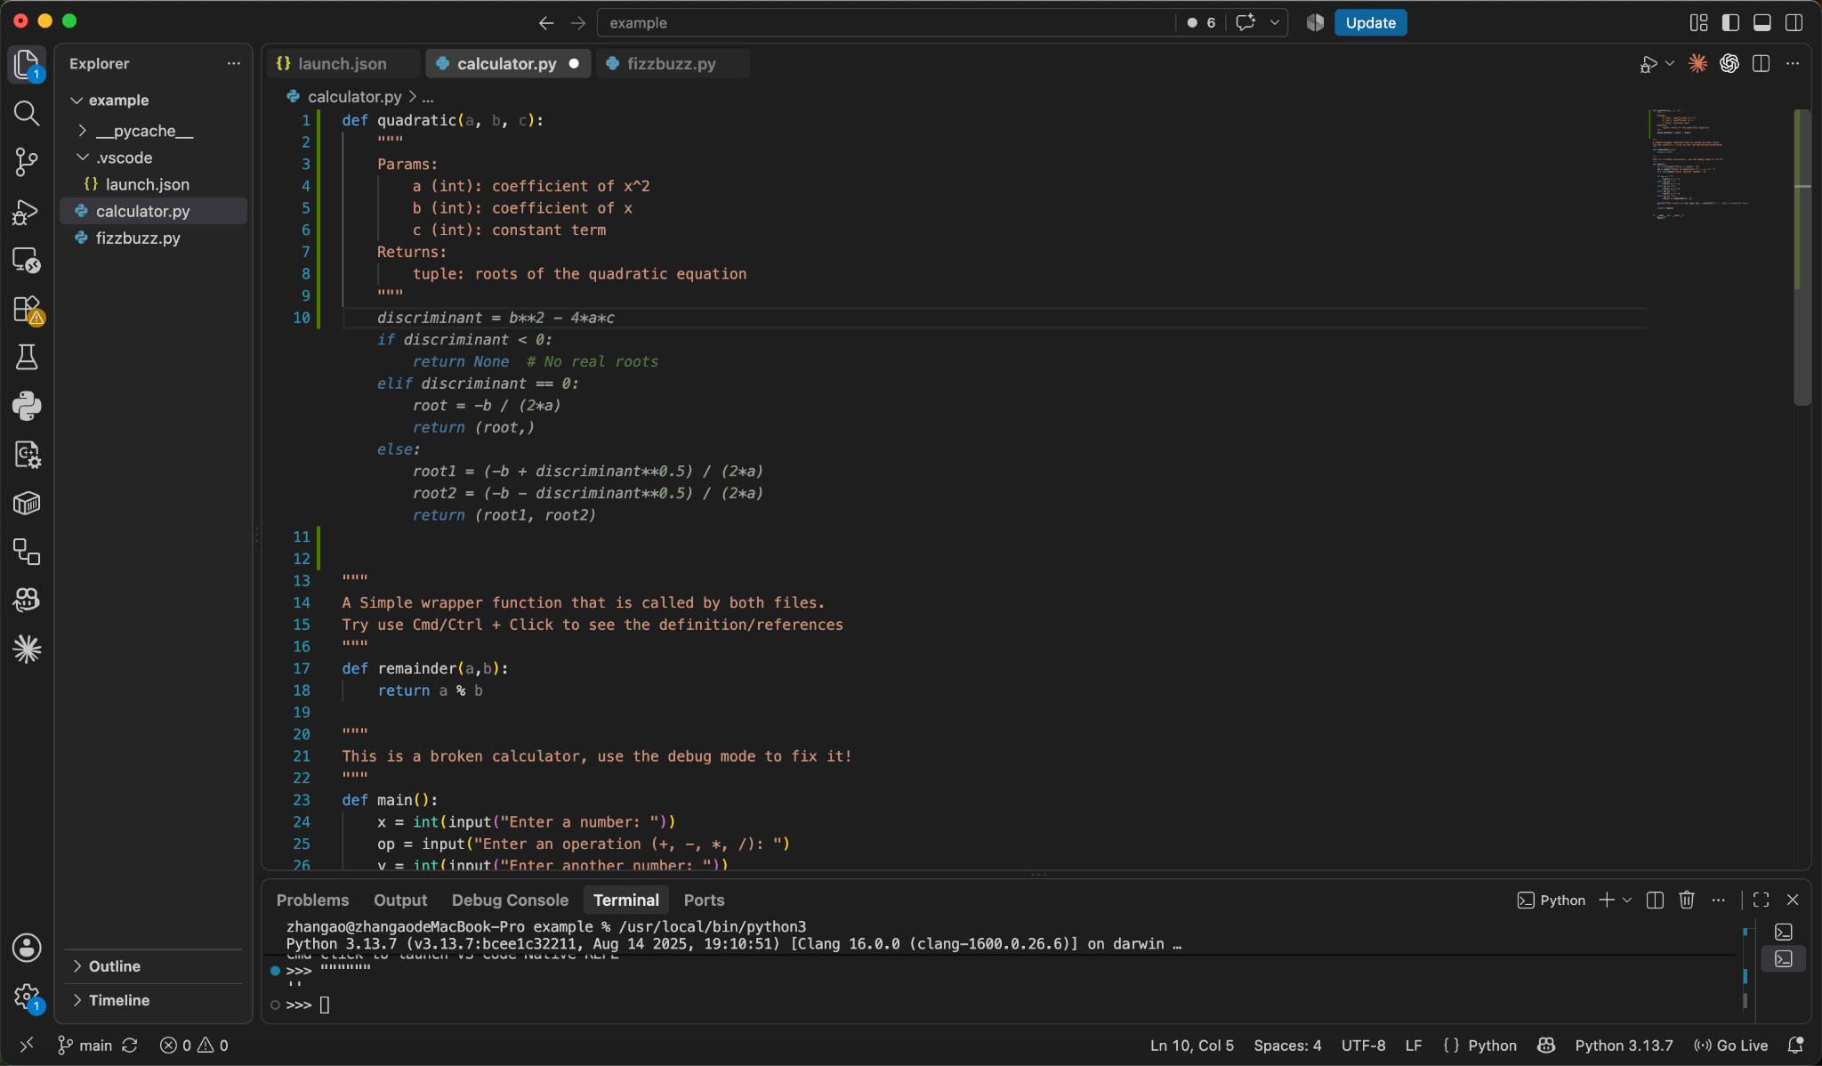
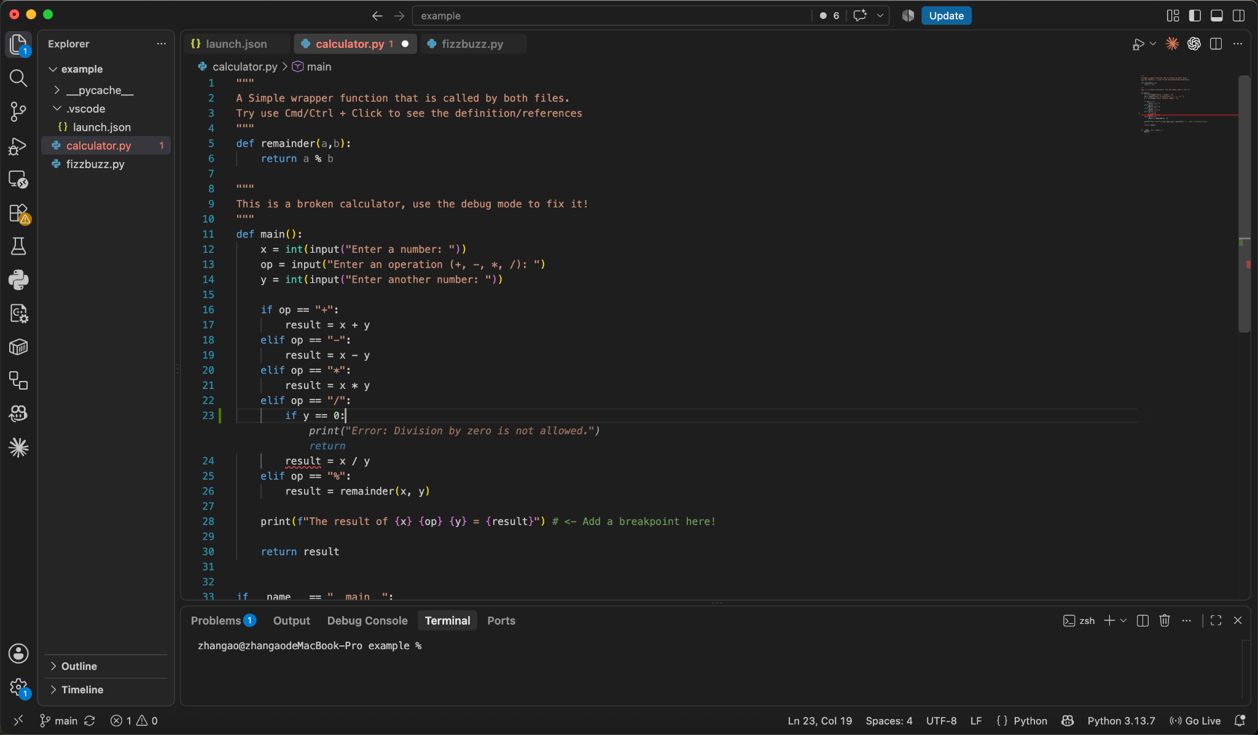

Autocomplete
AI agents can read your local coding context and try to make a guess to what you want to implement
Properties
  Only make local changes pass your cursor
  You can write comments to tell the agents what you want to do
  Has a limited understanding of the entire project

Slide 11
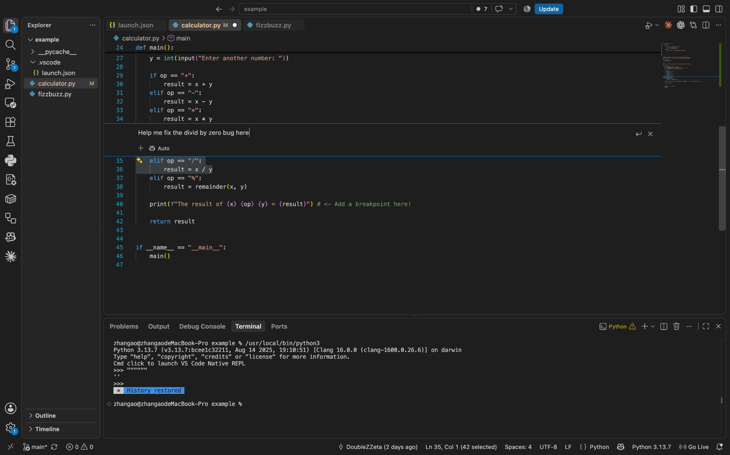
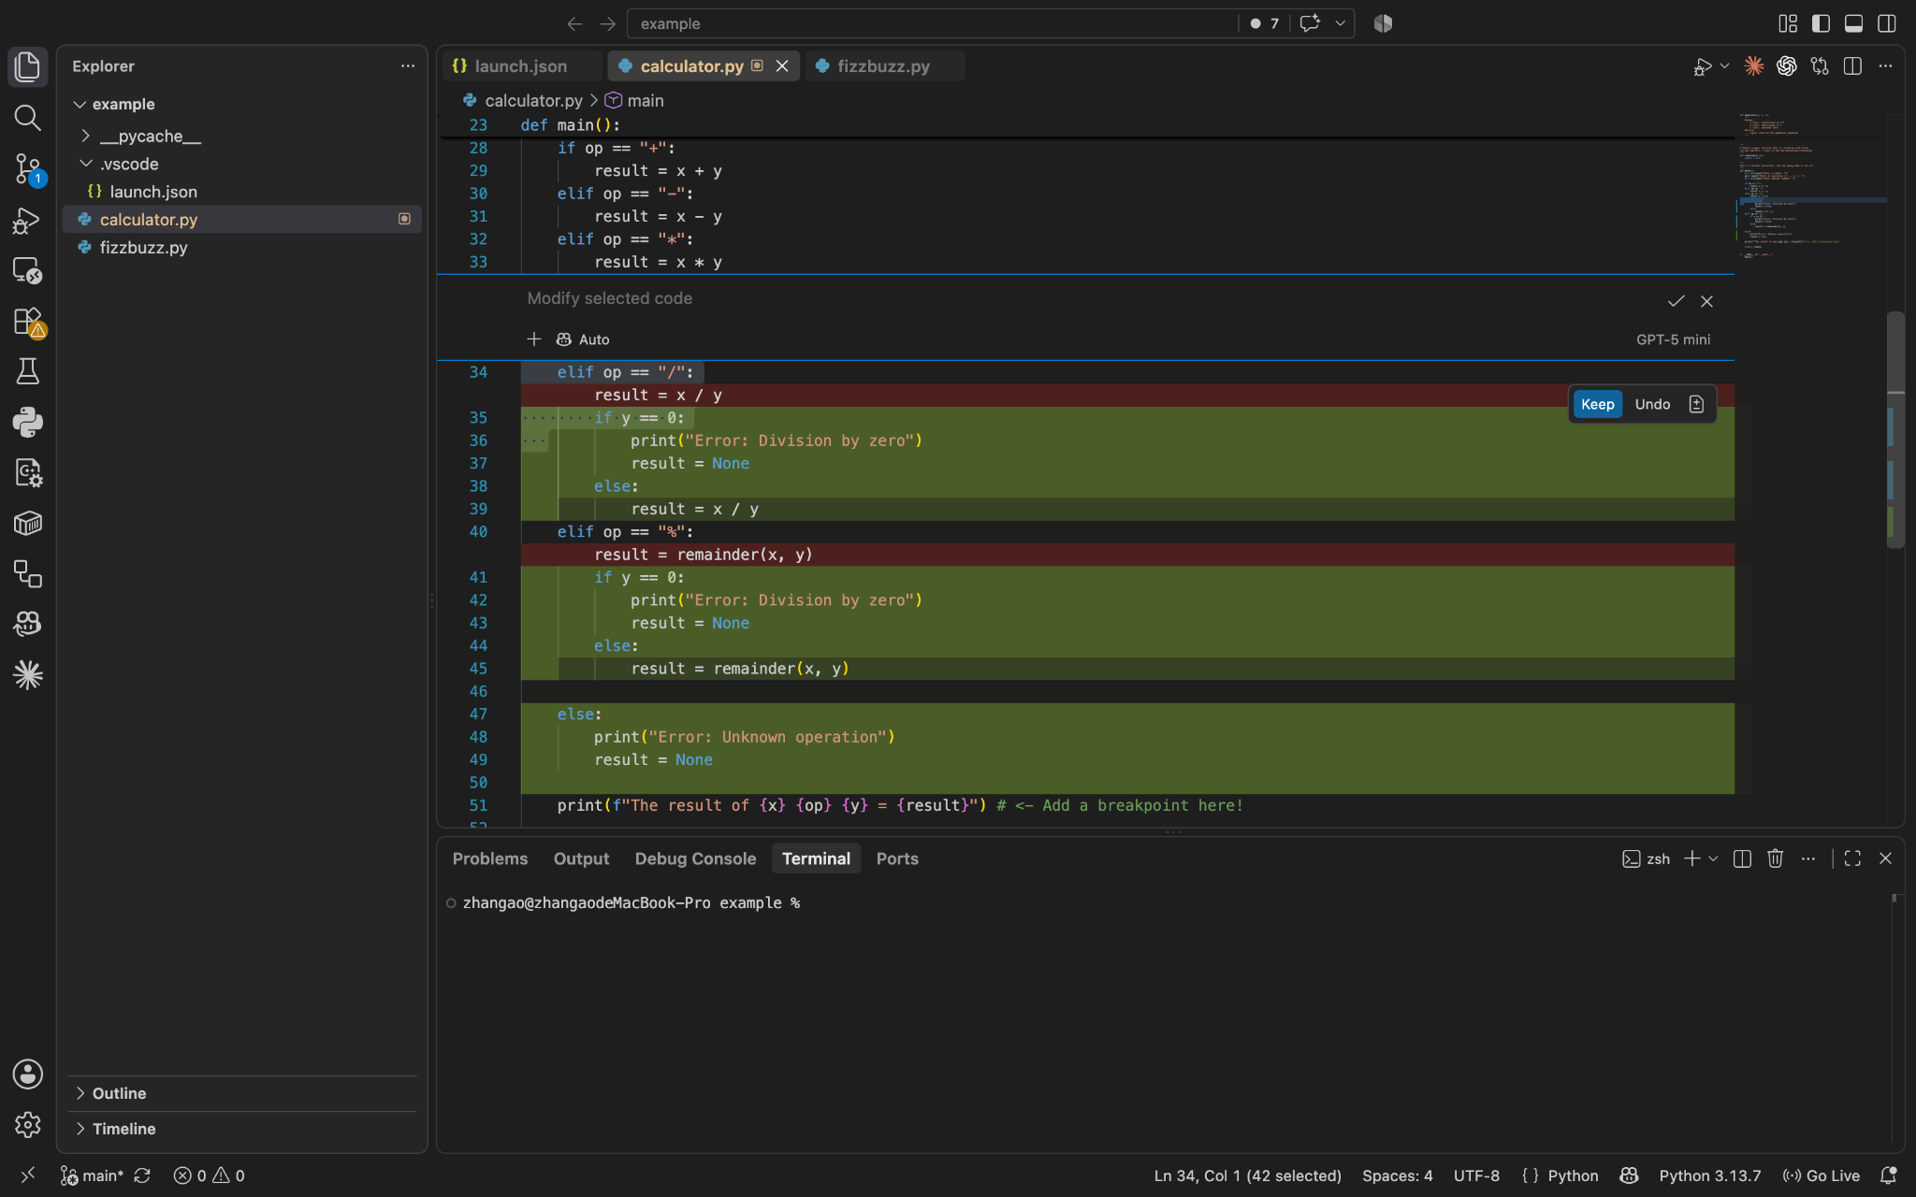
In-line Chat
You can drag-select a region of your code and use Ctrl/Cmd + i to ask the agent change that part of the code
Properties
  Only make local changes in the local region
  You can write comments to tell the agents what you want to do
  Has a limited understanding of the entire project

Slide 12
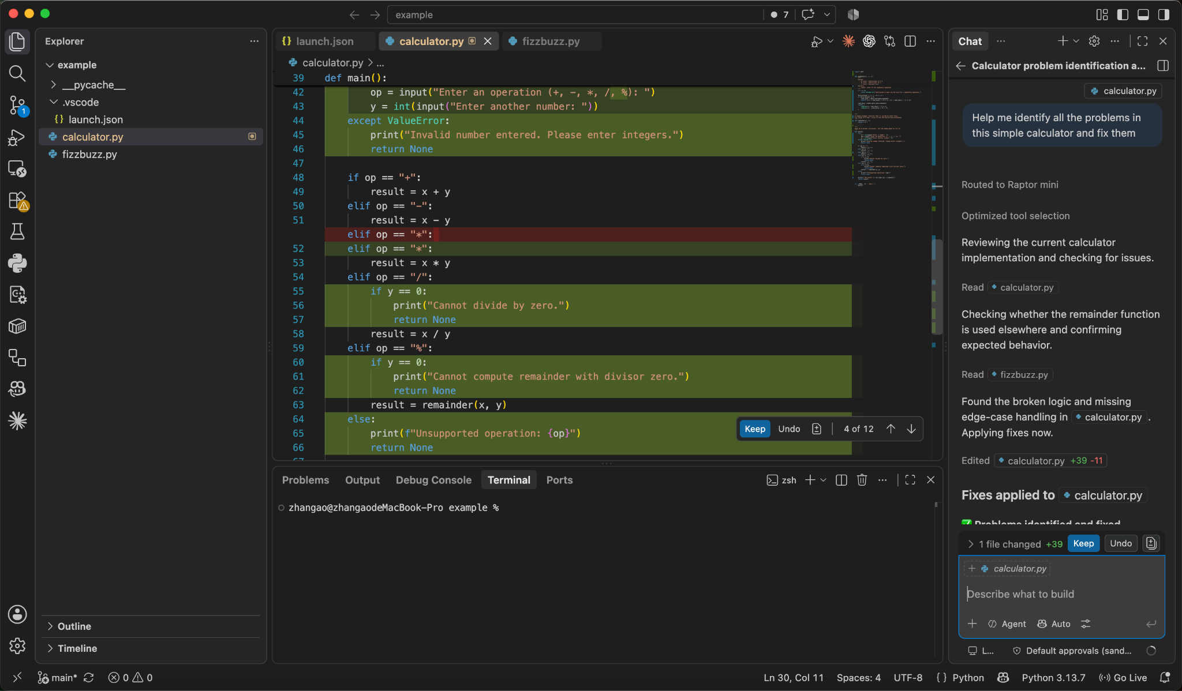
General Chat
You will see a sidebar on the right of your screen for all the AI extension
Properties
  Can make changes to all files in your working directory
  You prompt the agent to tell it what to do or implement
  Able to use the entire code base as the context

Slide 13
How to use them in Terminals

Slide 14
Download Agentic Coding tools for terminals
Most modern Agentic coding tools also support terminal-based workflows
You will need to install their CLI via your terminal, but these tools only support general chat function
Some useful links
  https://github.com/features/copilot/cli
  https://learn.chatgpt.com/docs/codex/cli#getting-started
  https://code.claude.com/docs/en/quickstart

Slide 15
Use cases & Features

Slide 16
Use cases for Agentice Coding
Code understanding: Agents can read a large code base and translate the logic to natural language
Fixing errors: Agents can help you identify hidden bugs. They are more useful in a feedback loop
Refactoring: Agents can free you from nasty refactoring process, from renaming to extraction
As a shell: Agents can help you complete the desired task without you knowing the low-level commands
Vibe coding, implementing new features: Typical use case. Test-driven development can be helpful here

Slide 17
Advanced features
Reusable prompts: You can design prompts that instructs the agents to work in a specific way, and you can resume that again and again
MCP: Model Context Protocol, an protocol that helps you connect your coding agent with tools, enabling it to do other tasks such as making Notion docs, even 3D modeling
Context management: LLMs have a limited context window, so you want the agent to have enough information but avoid unnecessary context.

Slide 18
Context management - continued
Basic managements: clear, rewinding, compaction
  Clear: use a different chat for irrelevant works
  Rewinding: you can add another prompt while the agent is still processing the previous one
  Compaction: summaries the chat history so that it saves the context window space
AGENTS.md: A README for agents, you can tell it to automatically read it every time
Skills: Reusable instructions for how to perform a task. Agents can choose to load skills, saving context

Slide 19
Privacy & Issues

Slide 20
Important note
Most AI companies use your conversion as a training data. If you tell the agent your personal information (passwords, etc.) there is a chance that someone can get it by prompt the agent in a certain way!
These agents are built on top of LLM, which as we discussed, is a probabilistic model. This means they do not “understand” things as humans, and they can produce sound but incorrect answers!
So be careful when you interact with such tools and do not fully trust them

Slide 21
Thanks for Coming!

